Slide 1
NEW YORK CRIME ANALYSIS by Team ANsRs

Slide 2
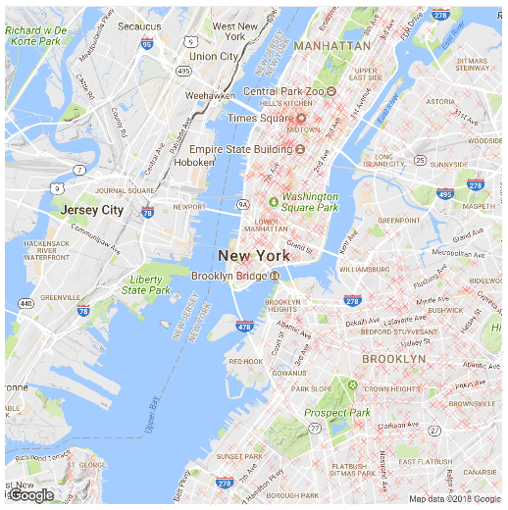
Crime Density Graph
for
NYC

Slide 3
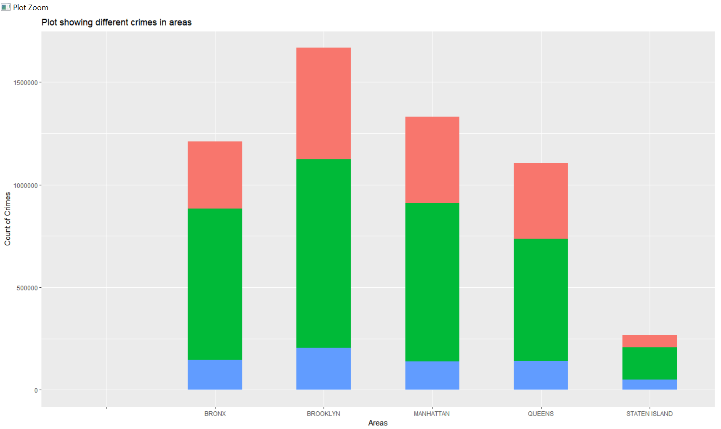
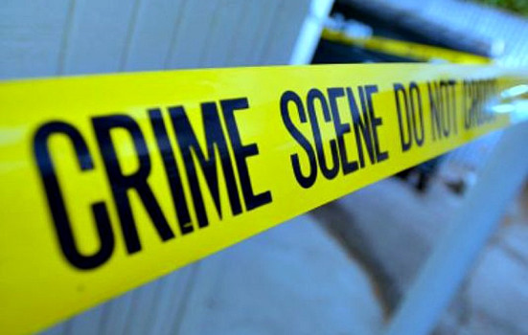

CRIMES IN DIFFERENT AREAS (Staten Islands Safer, Brooklyn dangerous)

Slide 4
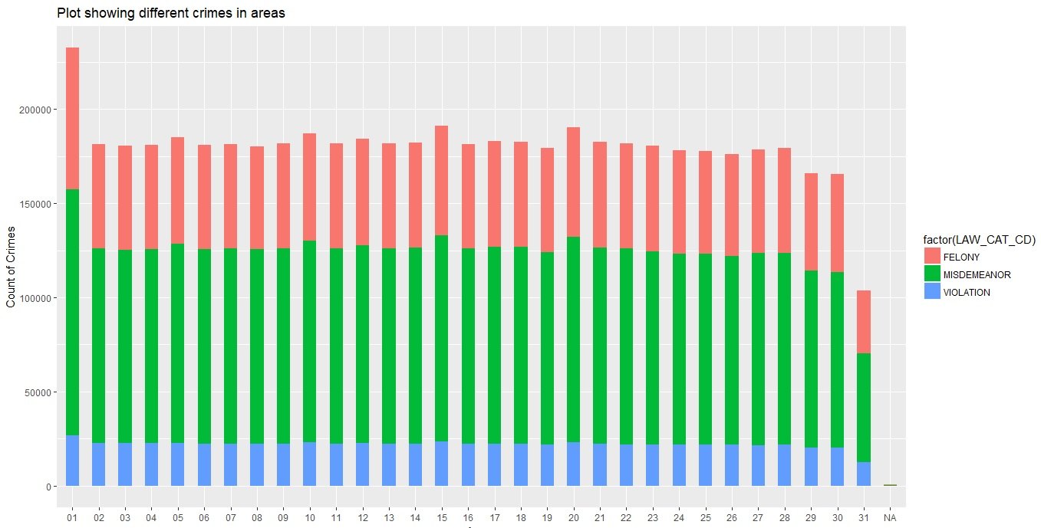
CRIME DOES NOT VARY BY THE DAY OF THE MONTH
Stay safe on all days specially day 1
Less for Day 31 as not all months have day 31

Slide 5
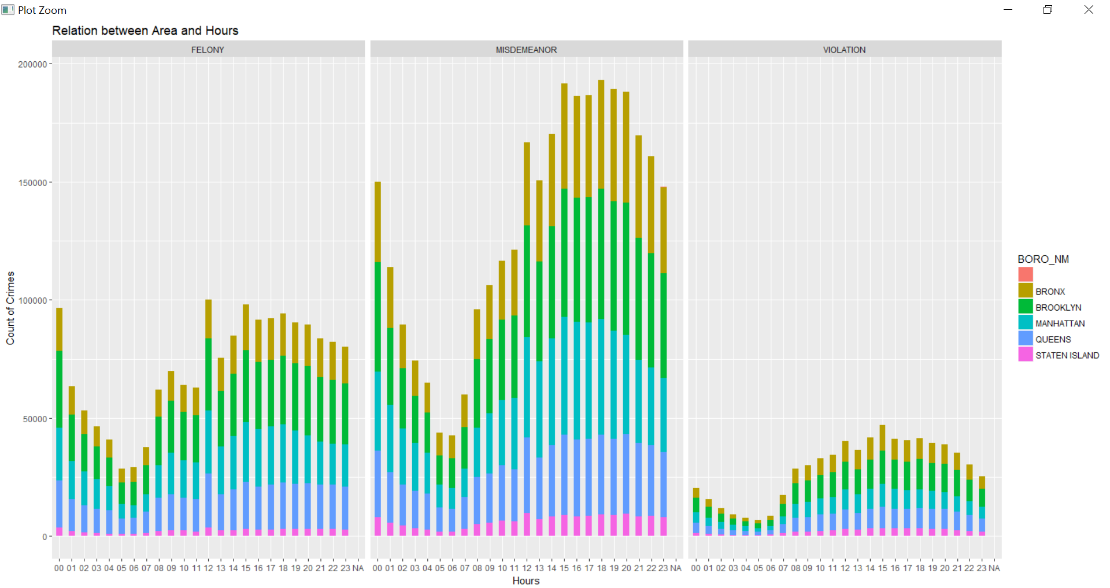
CRIME VARIATION BY HOUR OF THE DAY
Early mornings are generally safer
All categories of crime increase over the day
Slight decrease late towards the night

Slide 6
THANK YOU!

